Slide 1
π-Rates Interscholastic Spring 2024 Competition
Presented by the π-Rates Math Club

Slide 2
THIS SLIDE INTENTIONALLY LEFT BLANK

Slide 3
ANOTHER SLIDE INTENTIONALLY LEFT BLANK

Slide 4
Problem 01
Evaluate
5² + 5³

Slide 5
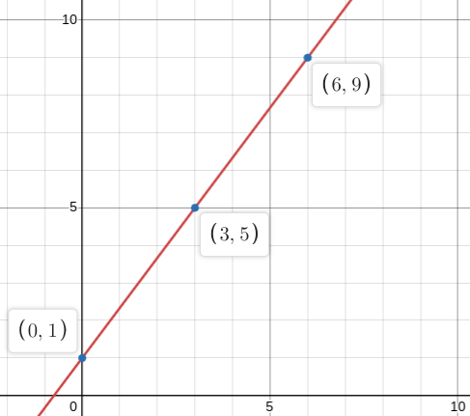
Problem 02
Find the slope of the line

Slide 6
Problem 03
What is the value of c?
c
12
9

Slide 7
Problem 04
A store owner makes $1080 in profit each day. How much, on average, does the store owner make per hour?

Slide 8
Problem 05
Solve for the smallest solution of x
x² + 5x + 6 = 0

Slide 9
Problem 06
Evaluate
1 + 3 + 5 + 7 + 9

Slide 10
Problem 07
Find the solution set of x that satisfies the following inequality:
6x - 8 > 7

Slide 11
Problem 08
Solve for the x value where f(x) = 0
f(x) = (x-5)²
9

Slide 12
Problem 09
It is 85°F in Sacramento and 10°C in New York. What is the difference in temperature, in Fahrenheit, between these two places?
°F = (°C * 9) + 32
5

Slide 13
Problem 10
The sum of 4 consecutive odd integers equals 280. What is the smallest of the 4 integers?

Slide 14
Problem 11
An business that makes $2800 in profit per week makes a $168000 investment. How many weeks will it take for the business to make back the money from its investment?

Slide 15
Problem 12
Find the median of the data set:
79, 100, 7, 56, 5, 77, 26, 61, 73, 89, 101

Slide 16
Problem 13
Evaluate
50 - 1 - 2 - 3 - 4 - 5

Slide 17
Problem 14
Find the volume of the cube
11

Slide 18
Problem 15
Expand
4x * (3x + 6) * 2x

Slide 19
Problem 16
What is the circumference of the circle (in terms of π)?
6.1

Slide 20
Problem 17
How much money do I have in total with 7 quarters, 11 dimes, 4 nickels, and 3 pennies?

Slide 21
Problem 18
18
What is the area of the trapezoid?
8
20

Slide 22
Problem 19
I buy a total of 40 red and blue tickets and spend a total of $150. Red tickets cost $2 each and blue tickets cost $4 each. How many tickets of each color did I buy in total?

Slide 23
Problem 20
Evaluate
(37 + 68) * 3
5

Slide 24
Problem 21
After being shortened by 20%, a test is 2 hours long. How long, in minutes, was the original test?

Slide 25
Problem 22
Solve the equation for x
4(3x-5) = 2x + 8

Slide 26
Problem 23
Find the mode of the data set:
3, 8, 3, 6, 8, 99, 23, 1, 2, 2, 1, 3

Slide 27
Problem 24
Solve for the (x,y) pair that satisfies the following system of equations
3x + 6 = 2y
4x - 2y = 10

Slide 28
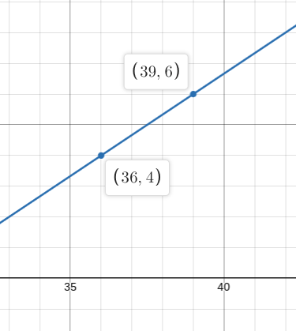
Problem 25
What is the y-intercept of this line?

Slide 29
Problem 26
Expand
-2(8x - 9) + 7

Slide 30
Problem 27
An electric car costs $49000. How much do I have to pay if I want to buy 4 electric cars(ignoring tax)?

Slide 31
Problem 28
Write the following fraction as a mixed number:
89 .
4

Slide 32
Problem 29
x°
What is the value of x?
64°
62°

Slide 33
Problem 30
Simplify and expand
5(4x-8)
2

Slide 34
Problem 31
Evaluate
234 x 239 x 34

Slide 35
Problem 32
What is the total volume of a box with dimensions of 7, 13, and 5?

Slide 36
Problem 33
Solve the equation for x
3x + 9 = 5.5x - 4

Slide 37
Problem 34
Solve the equation for x
2^{x} = 32

Slide 38
Problem 35
Solve for the largest x-intercept of
f(x) = 6x² - 4x - 16

Slide 39
Problem 36
x°
24
What is the value of x?
12√3
12

Slide 40
Problem 37
Find all 3 solutions for x
3x³ - 8x² + 4x = 0

Slide 41
Problem 38
You start off with 200 marbles. Every day that passes, you only keep 80% of the marbles that you had the previous day. How many marbles do you have after 2 days?

Slide 42
Problem 39
Find the solution set of x that satisfies the following inequality:
-2x + 5 < 2

Slide 43
Problem 40
Solve for the (x,y) pair that satisfies the following system of equations
3x + 6 = 3y
6x + 3 = 2y

Slide 44
Problem 41
Find the median of the data set:
7, 3, 5, 8, 2, 9, 10, 11, 200, 29, 4

Slide 45
Problem 42
What is the y-intercept of the following function?
f(x) = 34x⁶ - 2x⁵ + 47x - 7

Slide 46
Problem 43
What is the value of a?
25
20
a

Slide 47
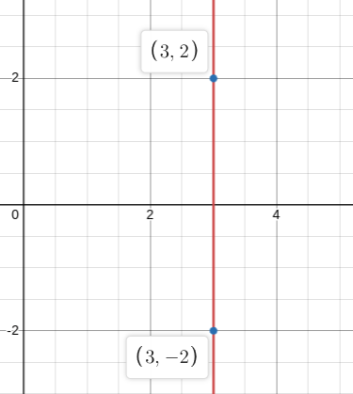
Problem 44
Find the slope of the line

Slide 48
Problem 45
What is the area of the circle (in terms of π)?
13

Slide 49
Problem 46
If I traveled 513 miles at a rate of 38 miles per hour, how much time have I spent traveling?

Slide 50
Problem 47
Write the following fraction as a mixed number:
12938 .
8

Slide 51
Problem 48
A TV screen has the dimensions x and y, where x is 5 units larger than y. If the TV screen has an area of 50 un², what are its dimensions?

Slide 52
Problem 49
In the following function, what does f(x) approach as x approaches infinity?
f(x) = 3x

Slide 53
Problem 50
If the temperature of a container is -40°F, what is the temperature of the container in °C?
°F = (°C * 9) + 32
5

Slide 54
Problem 51
The height of a projectile t seconds after it was launched is given by the function f(t) = -t² + 4t + 2. How many seconds after launch does the projectile reach its maximum height?

Slide 55
Problem 52
The product of 2 consecutive positive and even integers equals 288. What are the two integers?

Slide 56
Problem 53
The value of a car initially worth $40000 is reduced by 15% per year. How much is the car worth after 3 years?

Slide 57
Problem 54
Jonathan received the following scores on his past 5 tests: 60, 70, 46, 73, 91. What is the minimum score Jonathan needs on his 6th test to have an test average of 70?

Slide 58
Problem 55
Solve the equation for x
8x - 2 = 6
5

Slide 59
Problem 56
Find the mean of the data set:
3, 8, 25, 4, 6, 92

Slide 60
Problem 57
Given that 3(6x + 38y) = 10, what is the value of
9(3x + 19y)?

Slide 61
Problem 58
A list of 6 numbers is created where the first number is 4 and each number afterwards in the list is 7 more than the number before it. What is the sum of all numbers in the list?

Slide 62
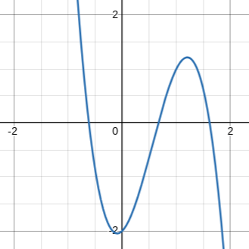
Problem 59
How many times does the following equation intercept the x-axis?

Slide 63
Problem 60
What is the area of the trapezoid?
12
16
5

Slide 64
Problem 61
Solve the equation for x
33x + 2387 = 1298

